Slide 1


Problem
Users
PRD
Backlog
Figma
Demo
Integration
01 · INTRODUCTION AND PROBLEM
VALUE PROPOSITION
Know if you fit
A clear route from discovery to application.
A free score with the reasons behind it
THE PROBLEM
Prepare with help
Job seekers in Germany search several boards, can't tell whether they fit a job, and don't trust rankings shaped by ads.
Strategy, CV and cover letter, every change approved
OUR SOLUTION
Stay in control
A job search copilot: one digest of public jobs, an explained fit score for every job, preparation tools you approve, one application history.
Apply yourself; nobody can pay for ranking
Notes:
[0:00–0:45] Hi, we're presenting CareerPilot: a clear route from discovery to application. The problem: job seekers in Germany search several job boards, they can't tell whether they actually fit a job, and they don't trust rankings that are shaped by ads and premium accounts. Our solution is a job search copilot. It collects public jobs into one digest, gives every job an explained fit score, helps prepare the application with documents the user approves, and keeps one application history. The value in one line: know if you fit, prepare with help, and stay in control.

Slide 2




Four people, one question: is this job a fit?
Problem
Users
PRD
Backlog
Figma
Demo
Integration
02 · TARGET USERS AND NEEDS
Markus
Lena
Andrei
Sofia
Senior engineer, Stuttgart
Graduate, Leipzig
Data engineer, Munich
Headhunter · pilot
PAIN
PAIN
PAIN
PAIN
60 job alerts a week, no time to check them
40+ applications, 3 interviews; does she qualify?
Three languages; fake recruiters ask for his ID
Manual CV search, unclear who can start now
HOW WE HELP
HOW WE HELP
HOW WE HELP
HOW WE HELP
One digest; skip a job in seconds on evidence
Fit score that counts projects and internships
Language level per job; documents in the ad's language
Opted-in candidates with ≥ 90% fit; CV only with consent
Personas are illustrative composites from our ideation workshop; interviews to validate them are planned.
Notes:
[0:45–1:30] Who are we building for? Four personas from our ideation workshop. Markus, a senior engineer, gets about 60 alerts a week; he needs one digest and to skip a job in seconds. Lena, a graduate, sent 40 applications and got 3 interviews; she needs to know whether she qualifies. Andrei works in three languages and has met fake recruiters; he needs the real language level and documents in the ad's language. And Sofia, a headhunter in our pilot, wants available candidates who truly fit, but only with their consent. These are illustrative personas; validating them with interviews is our next step.

Slide 3
The PRD defines what we build, for whom, and why
Problem
Users
PRD
Backlog
Figma
Demo
Integration
03 · PRD OVERVIEW
31
14
29
US2 · Must
See how my score is built and why the job fits
functional requirements
non-functional
user stories
Each criterion shows weight and contribution; they add up to the score.
MVP SCOPE
US3 · Must
My score reflects my fit, not missing profile data
Germany, German and English, web and mobile
Public job lists of the Bundesagentur für Arbeit
Free explained score; 10 credits a day for preparation
Invitation-only headhunter pilot
An incomplete profile still gets scores, with a confidence label.
US4 · Must
Every application saved to my history
Never: auto-apply, paid ranking, sharing a CV without consent.
Confirming "Did you apply?" saves date, source, documents and the job ad.
Open the PRD on Confluence · source of truth for every other artefact
Notes:
[1:30–2:30] Our PRD on Confluence is the foundation and the source of truth. It defines 31 functional and 14 non-functional requirements and 29 user stories. The MVP is deliberately narrow: Germany, German and English, web and mobile, jobs from the public Bundesagentur lists, a free explained score, and 10 daily credits for preparation. Three stories carry the core. US2: see how the score is calculated. US3: the score reflects fit, not missing data, so an incomplete profile still gets scores with a confidence label. US4: every application is saved with its job ad. And some things we will never do: auto-apply, paid ranking, or sharing a CV without consent.

Slide 4
9 epics, 29 stories, prioritised and planned in Jira
Problem
Users
PRD
Backlog
Figma
Demo
Integration
04 · BACKLOG AND SPRINT PLANNING
5
3
4
3
2
3
2
5
2
Profile
Discovery
Matching
Documents
History
Privacy
Career & interview
Headhunter
Consent
MoSCoW
sets the MVP scope
ACCEPTANCE CRITERIA · US4 · CPA-26
A fixed launch date means scope must flex: 13 Must, 6 Should, 2 Could.
Given I applied on the employer's site, when I confirm "Did you apply?", then an entry with date, source, documents and the saved job ad is created.
RICE
ranks inside the scope
Value per effort: "matching without a gate" scores highest, so it's built early.
SIX BUILD SPRINTS · 11 JAN – 2 APR 2027 · 79 POINTS
WSJF
orders the pilot
S1
S2
S3
S4
S5
S6
Profile
Discovery
Matching
Fit & privacy
Documents
Tracking
The 7 headhunter stories depend on each other; consent comes first.
DONE
backlog, criteria, sprint plan
PLANNED
sprint execution
Open the Jira board · numbers = stories per epic; dark = headhunter pilot
Notes:
[2:30–3:30] We turned the PRD into a Jira backlog: 9 epics and 29 stories. We used three methods, each for a reason. MoSCoW sets the scope, because our launch date is fixed, so scope has to flex. RICE ranks stories inside that scope by value per effort, which is why matching without a gate comes early. WSJF orders the seven headhunter stories, because they depend on each other and consent must come first. Every story has Given-When-Then acceptance criteria, like this one for the application history. The six build sprints are planned in Jira from January to April 2027, about 13 points each. The backlog and plan are done; executing the sprints is the next phase.

Slide 5
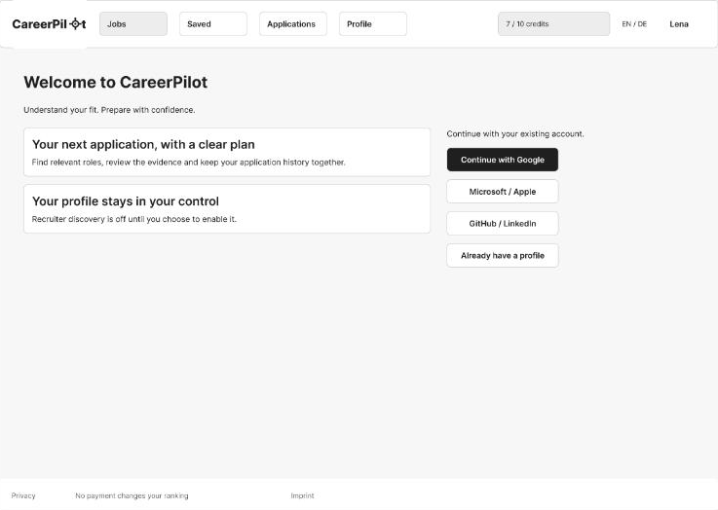
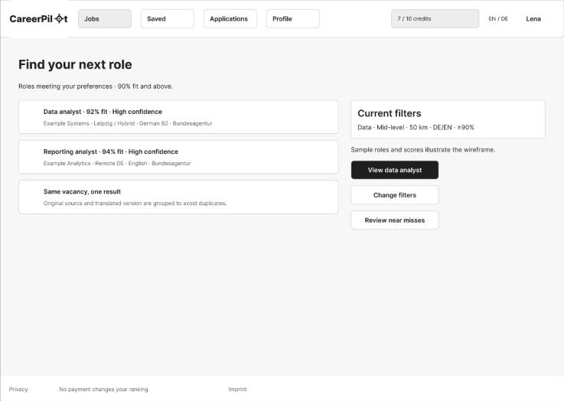
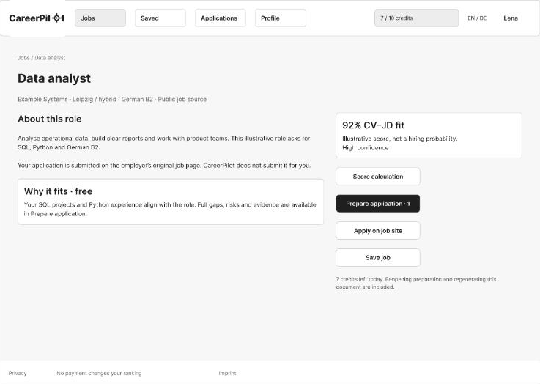
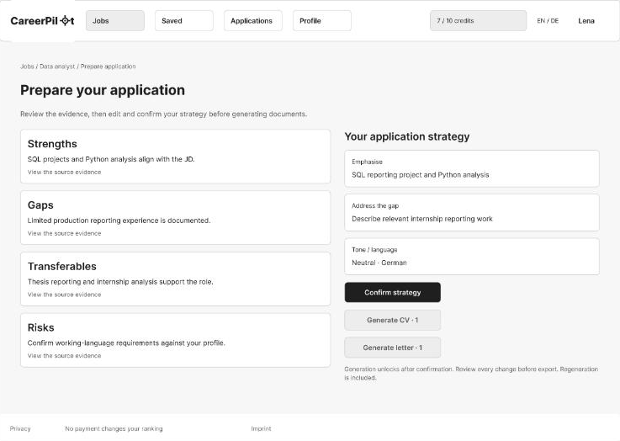
Lena's journey, screen by screen in the Figma prototype
Problem
Users
PRD
Backlog
Figma
Demo
Integration
05 · FIGMA AND USER JOURNEY
Sign in
›
Upload CV
›
Review profile
›
Preferences
›
Job list
›
Job detail
›
Prepare
›
Review CV
›
Did you apply?
Sign in: SSO, profile stays in your control
Job list: roles at ≥ 90% fit, near misses one click away
Job detail: fit, why it fits, Prepare · Apply · Save
Prepare: evidence, then a strategy you confirm
44 primary views 58 loading, empty and error states 1 mobile frame · task flows for every persona
Open the Figma prototype · grayscale wireframes, editable components and Auto Layout
Notes:
[3:30–4:30] In Figma we turned the stories into a clickable wireframe prototype: 44 primary views, 58 states for loading, empty and error cases, and one mobile frame. This is Lena's journey: sign in with SSO, upload a CV, review the profile, set preferences, see the job list, open a job with its fit score and why it fits, prepare the application with evidence and a strategy she confirms, review the tailored CV change by change, and confirm 'Did you apply?' so it lands in her history. The Flows page maps each persona's tasks to these screens, and every frame is annotated with the stories it covers.

Slide 6
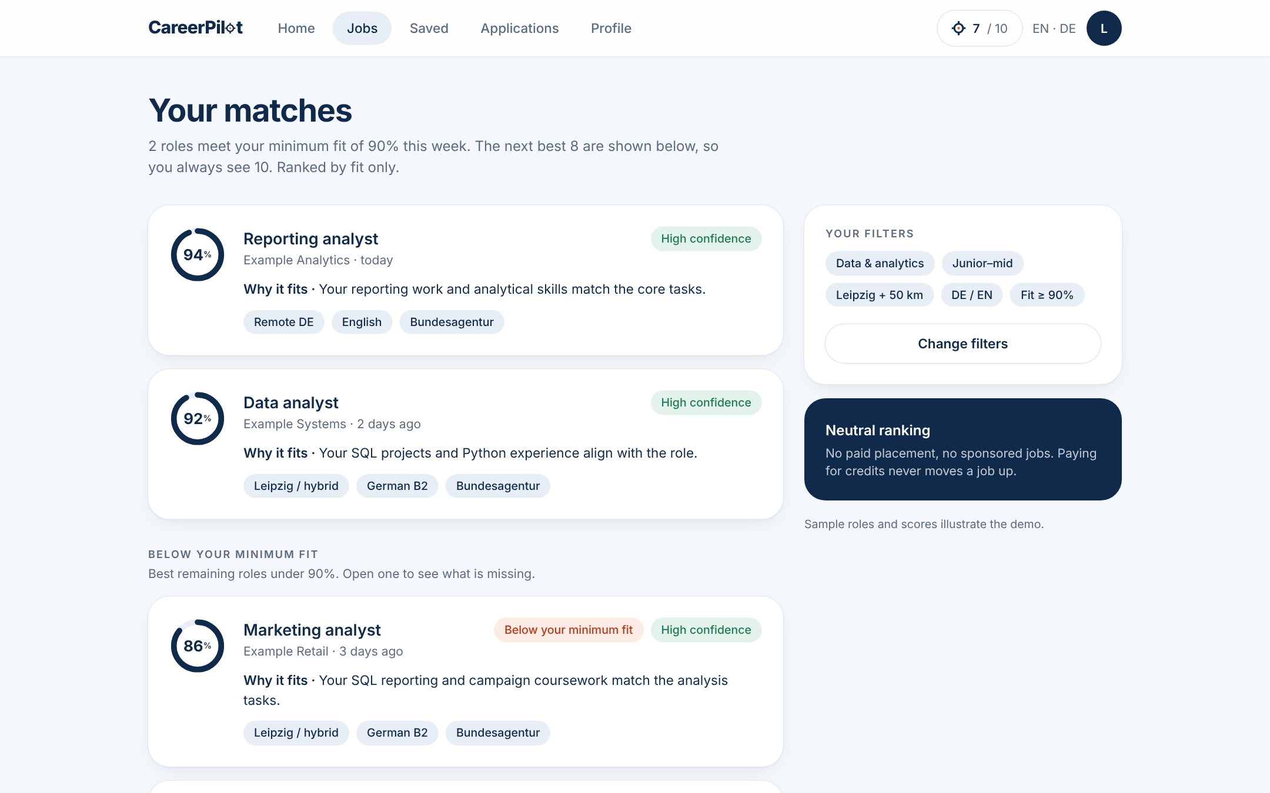
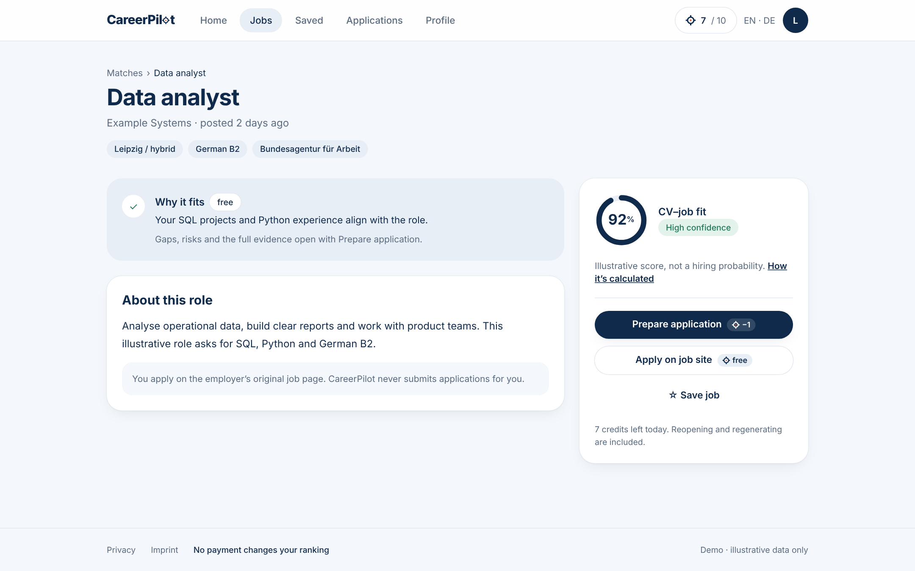
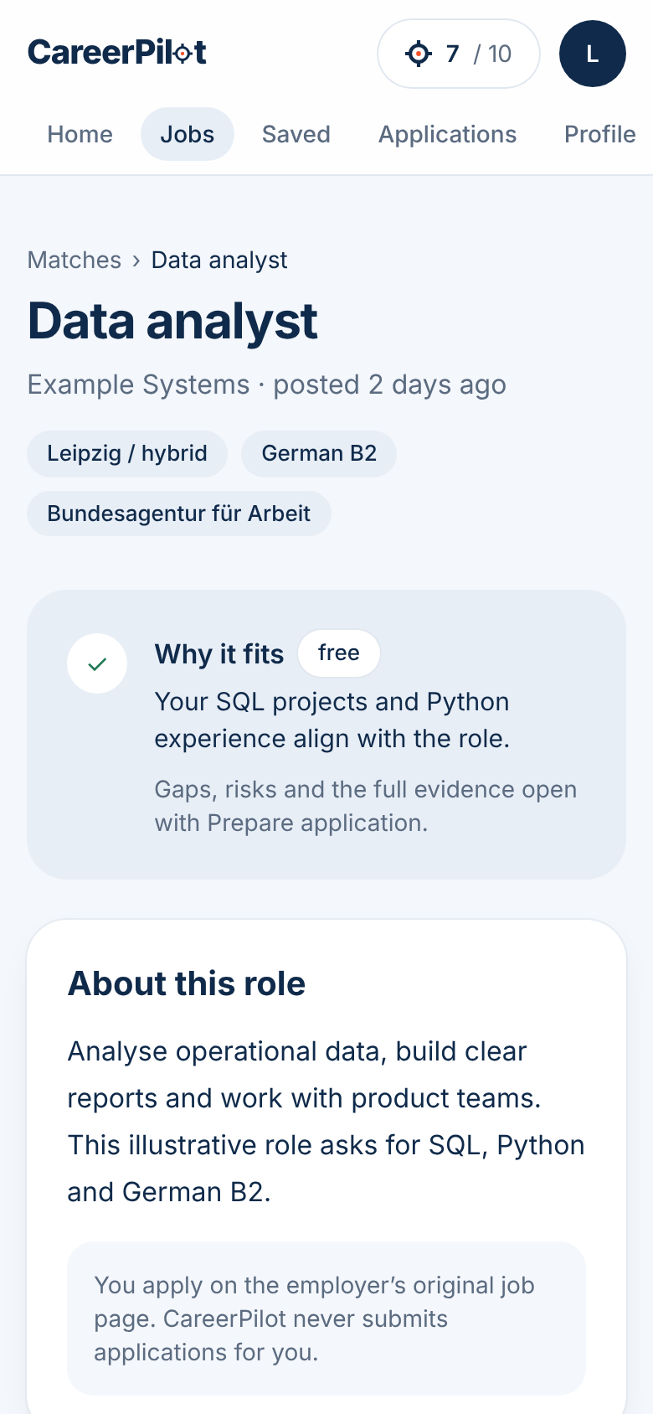
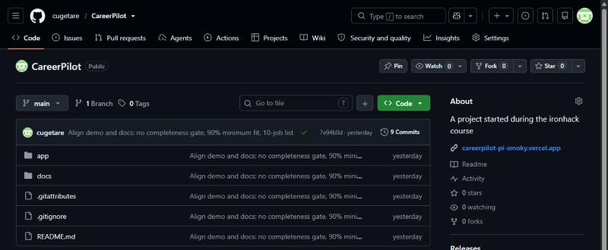
From wireframes to a working, clickable app
Problem
Users
PRD
Backlog
Figma
Demo
Integration
06 · LIVE DEMO · FIGMA AND GITHUB
GitHub: public repo, main branch deployed to Vercel
DONE
Next.js app, responsive, deployed
Job list: 10 jobs, 2 above the 90% minimum
Job focus: fit ring, Prepare (−1), Apply (free)
Mobile
PLANNED
Open the live demo →
Figma prototype
GitHub repo
Real CV parsing, AI and job data (simulated)
All jobs, scores and documents in the demo are illustrative. No real personal data is stored.
Notes:
[4:30–6:15] LIVE DEMO. Click 'Open the live demo'. (1) Sign in with any SSO button. (2) Upload CV, then Review: the profile is 72% complete, and scores still show. (3) Preferences: minimum fit 90%, then Show my matches. (4) Job list: two jobs above 90%, eight more labelled below the minimum, so Lena always sees ten. (5) Open Data analyst: the fit ring, why it fits, How it's calculated: the points add up to 92. (6) Prepare application spends one credit: strengths, gaps, transferables, risks, then confirm the strategy. (7) Generate the CV: review each change. (8) Apply on job site, then 'Yes, log application': it appears under Applications. Then switch to the Figma tab to show the same journey as wireframes, and the GitHub tab: public repo, docs and app folders, deployed from main to Vercel. Say clearly: the app is real and deployed, but CV parsing, AI generation and job data are simulated with illustrative data.

Slide 7
One connected package, from PRD to prototype
Problem
Users
PRD
Backlog
Figma
Demo
Integration
07 · INTEGRATION AND CONCLUSION
CONFLUENCE
JIRA
FIGMA
NEXT.JS · GITHUB
PRD
Backlog
Wireframes
Prototype
what and why
who builds what, when
how it looks and flows
how it works
Example: unclear fit (P3) → FR18, FR19 → US3 in Sprint 4 → job list and score screens → /jobs in the demo
Key decisions
Lessons learned
Next steps
No completeness gate: everyone gets scores
Public job lists only, no scraping
Free matching; credits pay for preparation
One source of truth: change the PRD first
A decision ripples through every artefact
AI drafts fast; we verify every claim
15 user and 5 headhunter interviews
Test the score on 100 expert-labelled pairs
Engineering and legal review, then build
A clear route from discovery to application. Thank you.
Notes:
[6:15–7:00] To wrap up: the four parts form one package. The PRD defines what and why, Jira turns it into stories and sprints, Figma shows how it looks and flows, and the Next.js prototype shows how it works. Every feature traces through all four; for example, unclear fit becomes FR18 and FR19, story US3 in sprint 4, the job list and score screens, and the jobs page in the demo. Our key decisions: no completeness gate, public job lists only, and free matching with paid preparation. What we learned: keep one source of truth, expect every decision to ripple, and verify what AI drafts. Next: interviews, testing the score against expert labels, and an engineering and legal review before building. Thank you.

